Slide 1
Team Id: H26EDU10
Project Title - VerifyEdu
Team Lead Name - Mustafa Sethjiwala
Team Members Name - Subham Kumar Gupta, Sneha Arya
College Name - National Institute of Technology, Tiruchirappalli

Slide 2
Problem Statement
Students can use AI tools to do their assignments without having any real knowledge of the subject. There is no way to check whether the student has really learned the concepts.
Objective of our solution
Verify genuine student understanding, not just detect AI-generated text
Generate assignment-specific quizzes automatically using AI.

Slide 3
Existing solutions
Turnitin
A tool that schools and colleges used to check student writing for plagiarism, text matching, and AI generate content.
GPTZero
Online AI detection tool that tells whether a document or text was written by a human or generated by a large language model
Copyleaks
AI-powered software used to detect plagiarism, check for AI-generated text, and verify content authenticity.

Slide 4
Identified Gaps
High false positives penalize genuine students
Turnitin sometimes give high percentage of similarity score as all the students submit solutions to the same problem, a lot of their text matches with each other.
Detection != Comprehension
All existing tools answer “was this written by AI?” not “does the student understands what they submitted?”, which is more important.
Teacher’s dilemma
Existing tools output a probability score, not a diagnostic. Teachers get a flag, but no way to verify actual understanding.
Detectors are somewhat beatable
In controlled testing, every major detector returned less percentage of AI score.

Slide 5
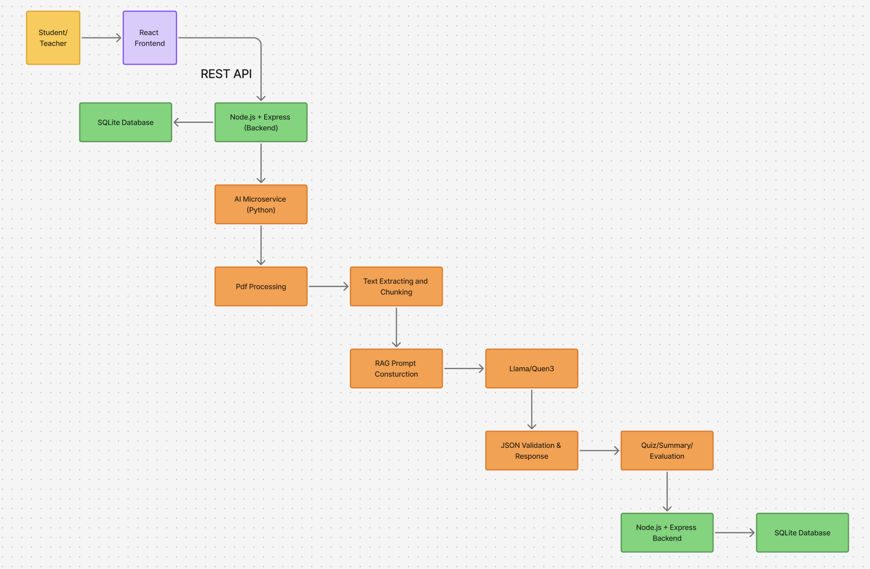
Block
diagram

Slide 6
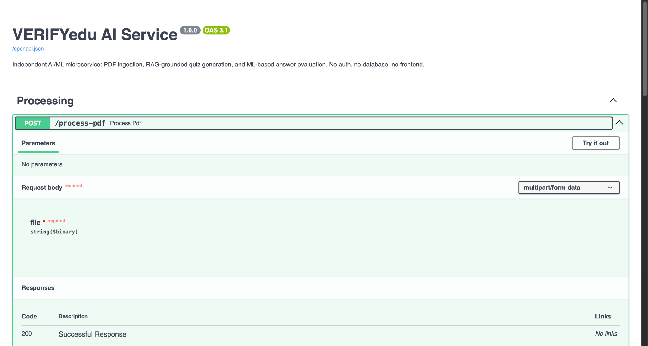
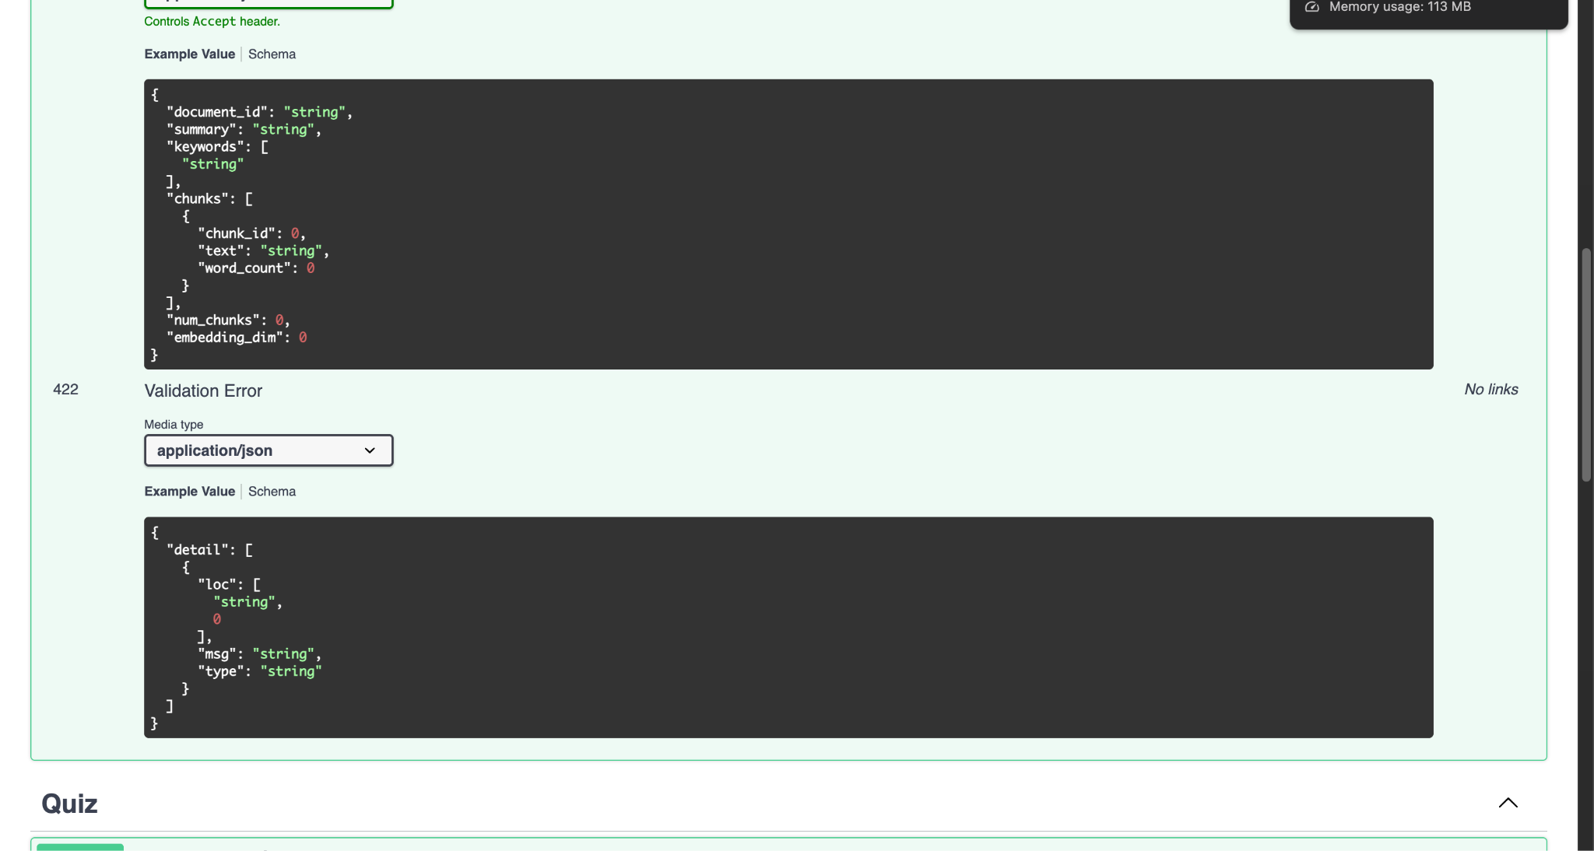
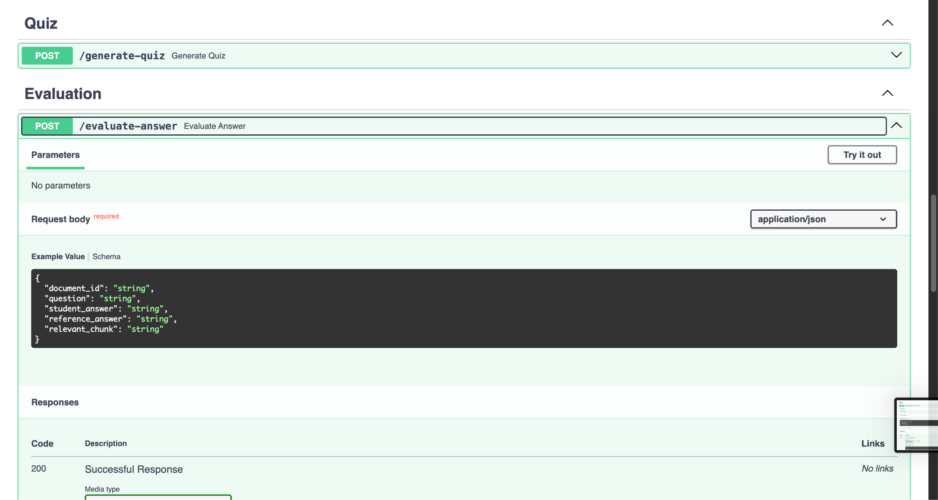
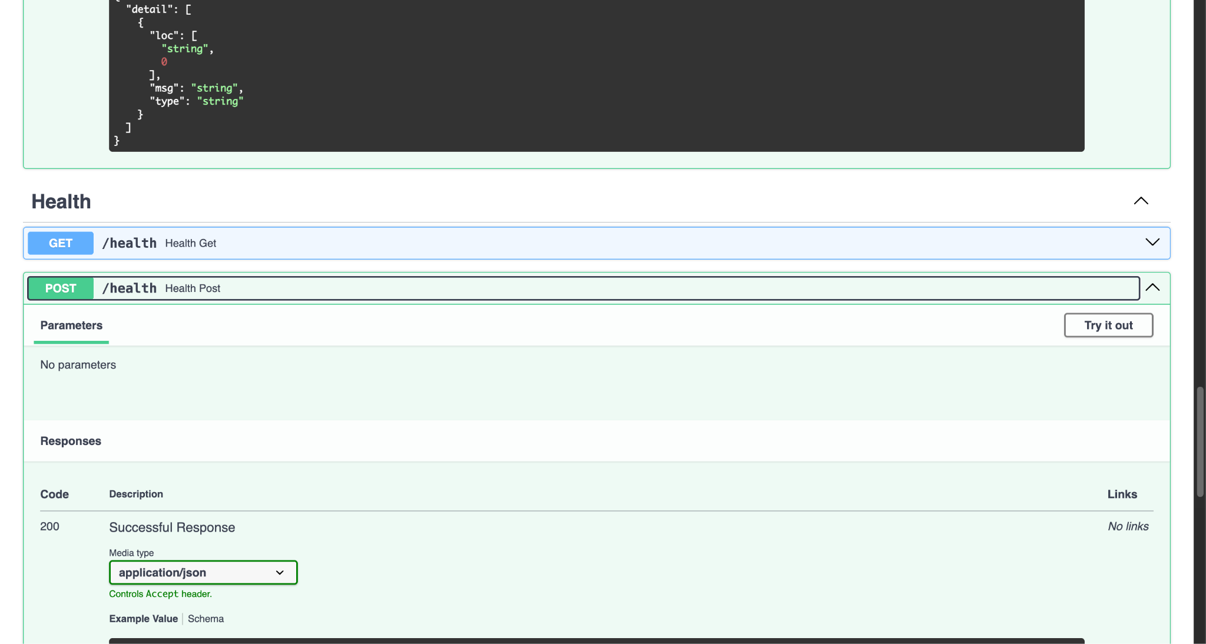
Implement Progress
API generation in JSON formate Document id
Questions
Question ans
Reference answer
Relevant chunk

